Slide 1
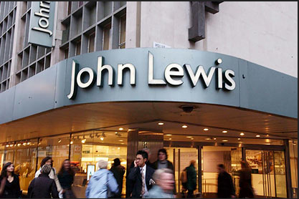
Session 2
OMG!
Operations

Slide 2
I am thinking of a key operations term for Unit 3
Which one?

Slide 3
A three letter acronym
Let’s hope it arrives on time…
Let’s keep things “lean”
Don’t want to hold too much!
Time to take stock…

Slide 4
Better productivity might help this
I’m just one word – but an important one
Without it, my business cannot succeed
My competitors want this too
I try to win!

Slide 5
Stock Control
Method 1
Method 2
This means that the business always holds a certain amount of stock and re-orders when stock levels reach a re-order amount
Buffer Stock (JIC)
This means that the business only orders stock to arrive just before it is needed and therefore holds no buffer stock
Just In Time

Slide 7
What method of stock control are John Lewis employing?

Slide 8
Identify and explain one advantage of this for John Lewis
One advantage is
This means that
Consequently
shoppers are likely to see and potentially purchase a wider range of goods, improving the firm’s revenue.
that this approach requires less space to store stock.
John Lewis will be able to use more of the space in the new stores to put items on display for customers.

Slide 9
Identify and explain one disadvantage of this for John Lewis
One disadvantage is
This could lead to
As a result
that John Lewis will be unable to hold large quantities of stock.
John Lewis may lose business since customers will go and purchase the picnic equipment elsewhere
stock-outs if a particular product becomes popular such as picnic equipment in the summer.

Slide 10
Identify and explain two benefits of customer service
One benefit of good customer service to John Lewis is that customers will enjoy the experience of shopping at their stores.
This means that they are likely to return in the future when they next need to purchase an item stocked at John Lewis.
As a consequence of this John Lewis will have a loyal customer base who regular spend money at John Lewis, increasing their revenue and profits.
1

Slide 11
Identify and explain two benefits of customer service
One benefit of good customer service to John Lewis is that it adds value to the experience offered to customers in store.
This means that customers will be willing to pay a higher price for their goods in the knowledge that they will receive friendly and knowledgeable advice
As a consequence of this John Lewis will be able to earn greater profit margins on the products it sells
2

Slide 12
Explain one way in which John Lewis provide good customer service
Ensuring tills are manned
Provide advice on products offered
Swiftly deal with complaints in a sincere, caring way
Have a good range of stock available

Slide 13
To deliver effective customer service what would John Lewis need to do?
Action: Provide training to staff
Action: Set up a complaints process
Explanation
This will enable staff to give advice to customers on the most suitable products for their needs. As a result customers will feel confident about their purchase. This will mean they will be happy to buy from John Lewis again in the future.
Explanation:
By ensuring there is a clear process, staff will know what they are able to do in order to deal with a complaint. This will mean that customer complaints can be quickly resolved. Consequently this will protect John Lewis’ reputation from being damaged and maintain it’s loyal customer base.

Slide 14
Examiners Tip
What is meant by the term...?
These questions should be easy marks as long as you have done your revision! The only terms that have appeared in previous exam papers are off the ‘what students need to learn’ column of the specification. Ask your teacher if you are unsure!

Slide 15
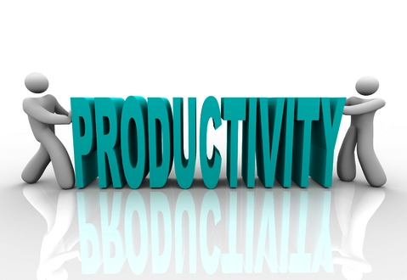
What do we mean by...

Slide 16
Productivity is...
The level of output, in units of production, per employee in a specific period of time

Slide 17
Two methods of improving productivity?
1
Provide training to staff so that they can improve the speed and accuracy of their work
2
Increase motivation by offering piece rate pay in order to encourage workers to produce more

Slide 18
3 methods of reducing costs
Easy Jet – aero-dynamic paint to reduce drag and fuel consumption
Nike – created a ‘Trash Talk Shoe’ made from waste from other shoes
Dyson – relocate manufacturing to Malaysia for cheaper labour and proximity to key markets

Slide 19
Be the Examiner
How many marks would you award the answer on the next slide and give me 1 way it can be improved?

Slide 20
Describe one advantage to John Lewis of improving the productivity of their staff
Improved by
Have a go at turning this answer into a 3/3
Focusing on advantages, not how.
Sticking to one point and developing it.
One way of improving the productivity is to give the staff more training so that
they can do their job more effectively.
Another good way to do it would be to pay
their staff a bonus for achieving a certain amount of work, or they could set up a
suggestion scheme so that staff could put forward ideas about how things could
be done better.
/3
0

